Slide 1
Retail data analysis by text mining
Syed Norman Daniel Bin Syed Mahadir(P125754)
Muhd Hilman Bin Rozaini (P121535)

Slide 2
AGENDA
Introduction
Objective
Data Cleaning
Data Manipulation
​Data Text Mining Analysis
​

Slide 3
What is online data retail
Information collected from e-commerce websites and platforms
Business decisions and customer behavior
Customer experience, target marketing efforts, and improve the overall performance of the online retail business.

Slide 4
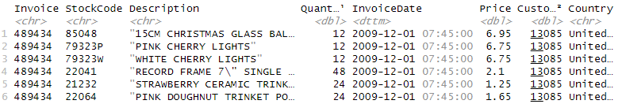
Data background
This Retail Data contains a raw data set transaction of customer with different purchase item.
This Data set which contains 7 columns and 525461 rows.

Slide 5
OBJECTIVE
To understand and investigate the customer behavior on the specific item shops in data retail using text mining analysis
To specific which items are the most purchase in this data set.

Slide 6
DATA cleaning

Slide 7
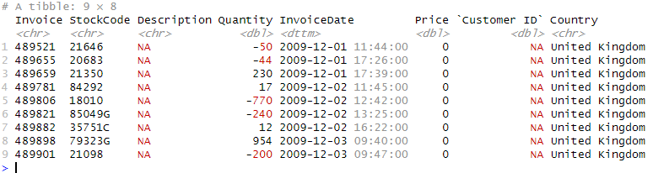
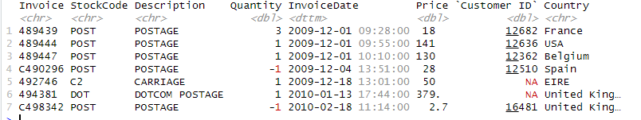
DATA CLEANING
Check NA value on Data in column Description and Negative value in column Quantity,
Remove Service, tax and similar with it.

Slide 8
Data Package for data mining text analysis
library("tm")
library("quanteda")
library("quanteda.textstats")
library("quanteda.textplots")
library("wordcloud")
library("RColorBrewer")

Slide 9
Text analysis
-> wordcloud
-> textstat frequency
-> textstat keyness
-> keyword in context (KWIC)

Slide 10
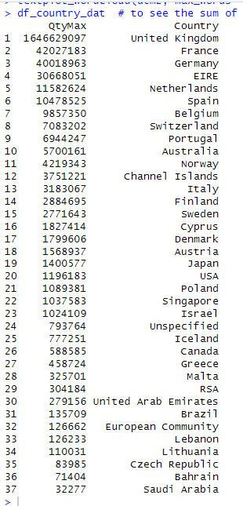
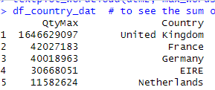
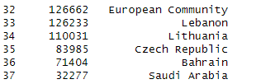
COUNTRY WITH THE MOST PRODUCT DEMAND IN ONLINE RETAIL
For some sample, we will be using "United Kingdom" & "Singapore" as the selected samples for certain illustration of text analysis

Slide 11
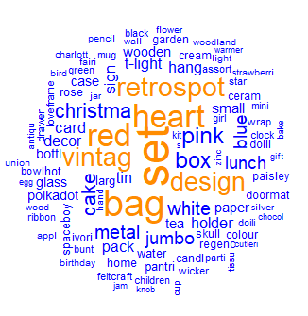
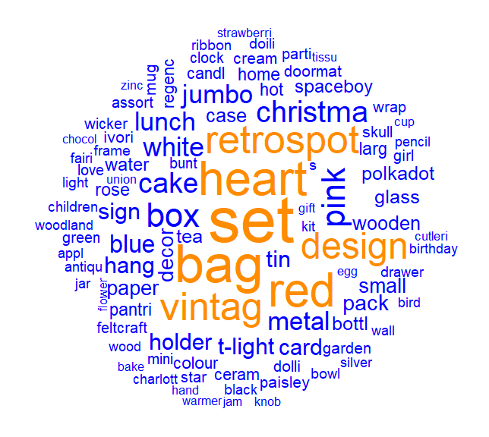
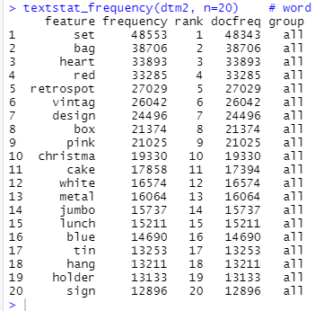
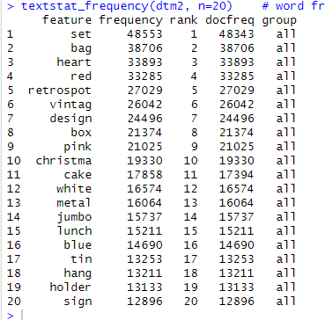
Wordcloud & textstat_frequency
It illustrates the most significant words used in the product description in across 37 countries.
Table showing the most frequenctly used word in the whole retail online dataset across 37 countries
textplot_wordcloud(dtm2, max_words = 100, color = c('blue','darkorange'))

Slide 12
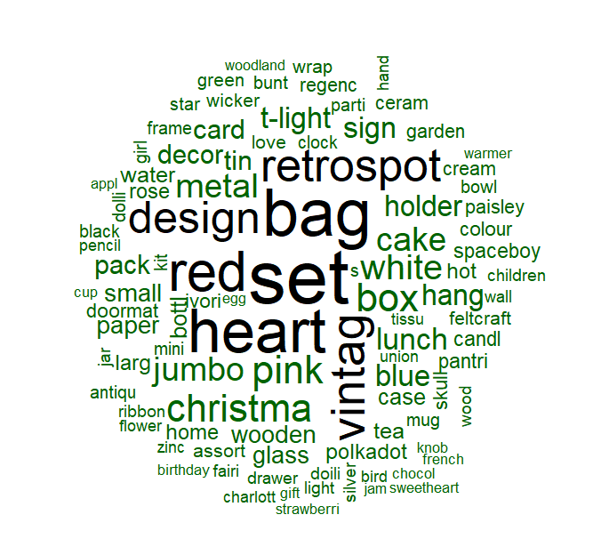
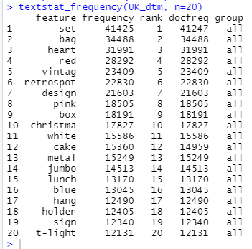
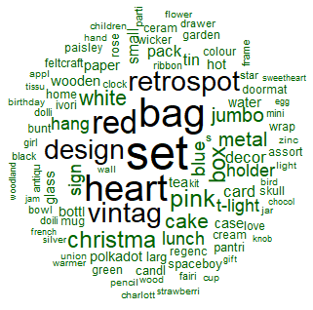
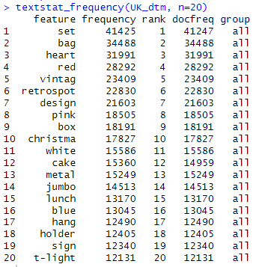
WORDCLOUD & textstat_frequency
Selecting sample country with the highest product demand: UK
It illustrates the most significant words used in the product description in UK only

Slide 13
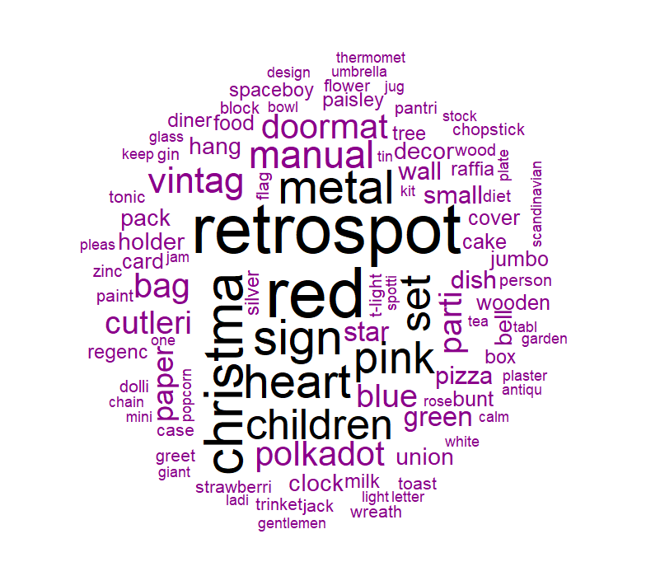
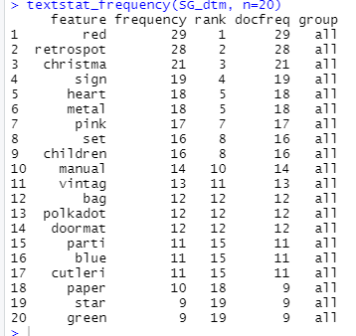
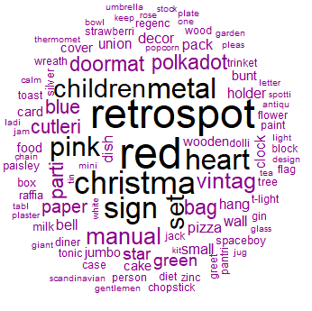
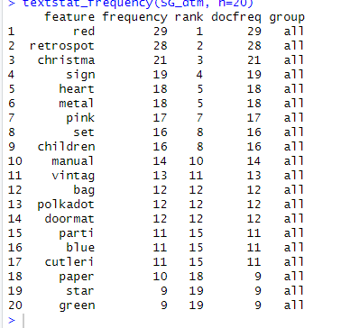
WORDCLOUD & TEXTSTAT_FREQUENCY
Selecting sample country randomly: Singapore
It illustrates the most significant words used in the product description in Singapore only

Slide 14
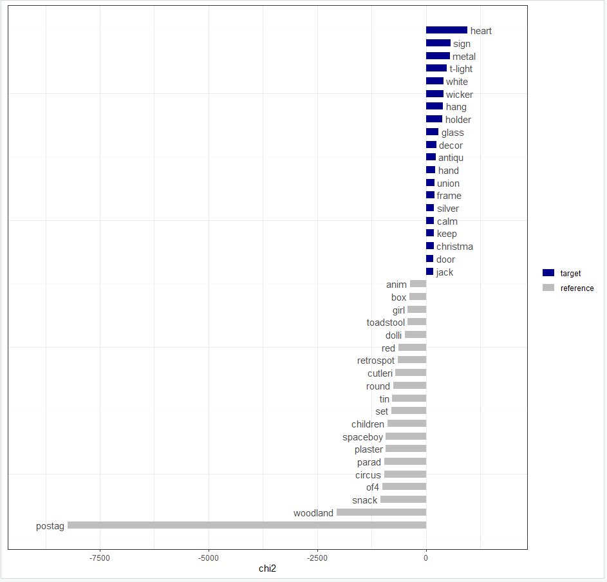
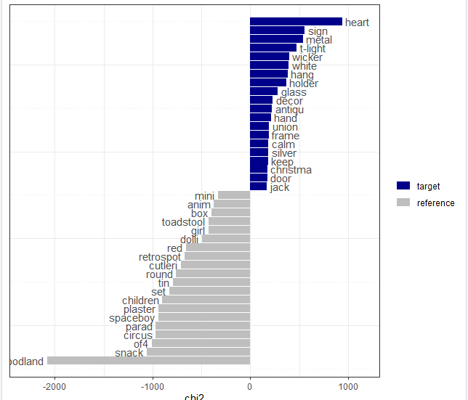
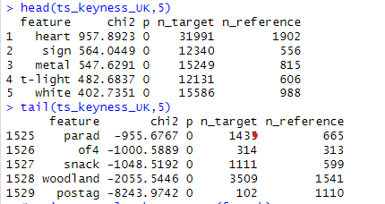
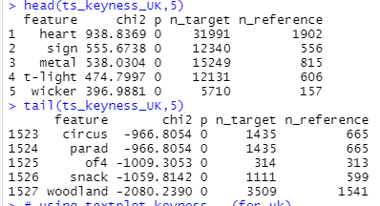
TEXTSTAT_KEYNESS (uk)

Slide 15
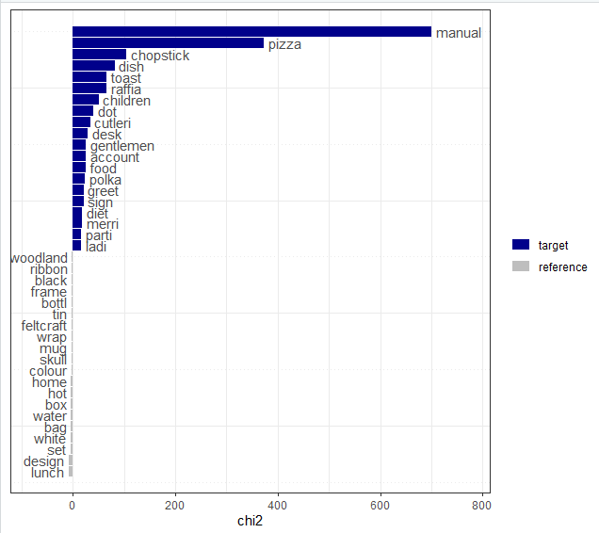
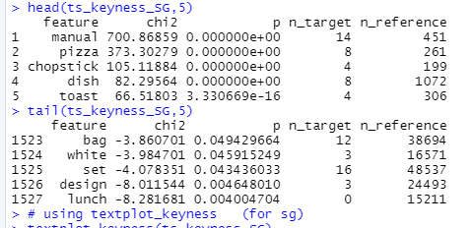
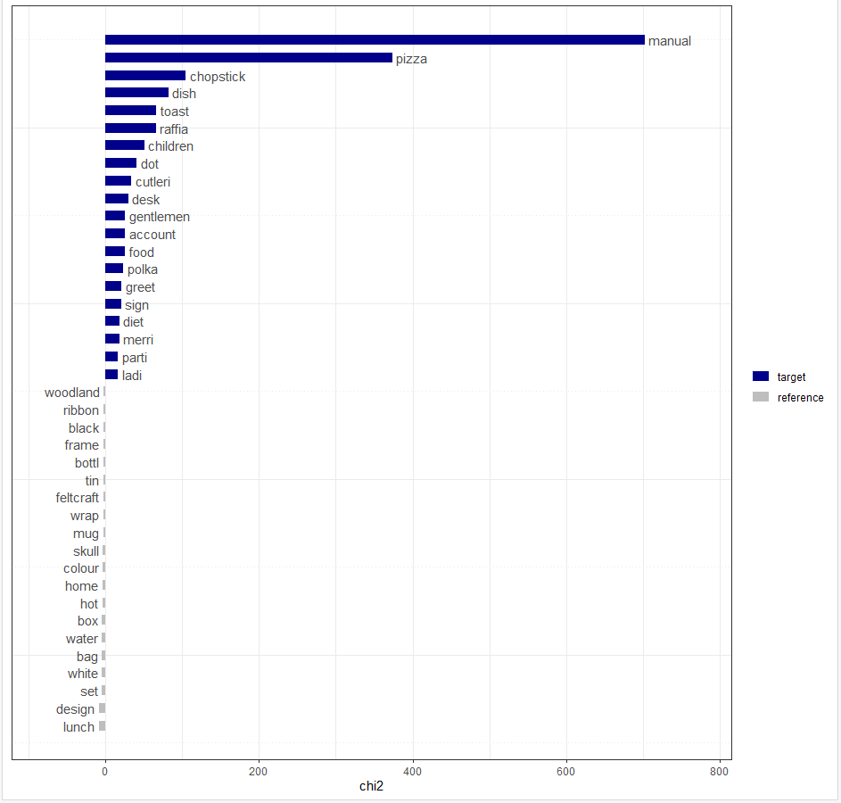
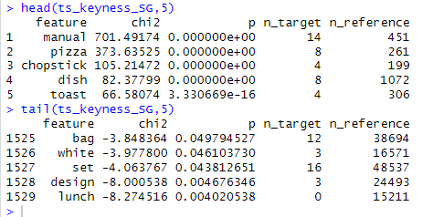
TEXTSTAT_KEYNESS (sg)

Slide 16
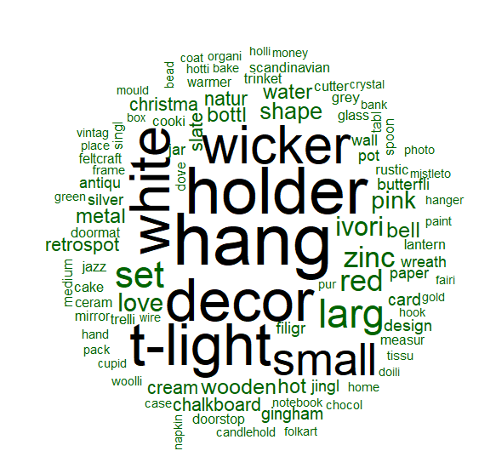
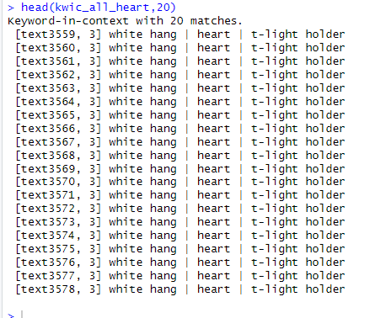
Keyword in context ("heart")
kwic_all_heart<- kwic(tokens(text3), "heart", window=5 ) #top used word in UK
head(kwic_all_heart,20)

Slide 17
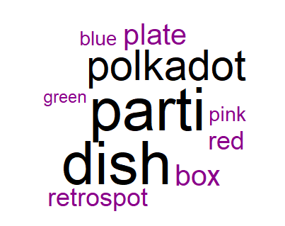
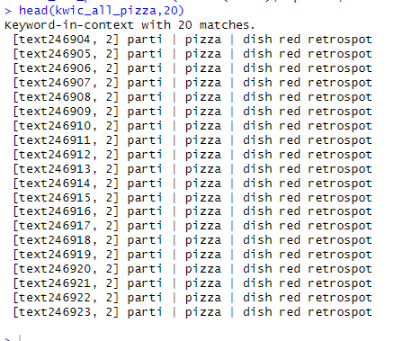
Keyword in context ("PIZZA")
kwic_all_manual<- kwic(tokens(text3), "pizza", window=5 ) # top used word in SG
head(kwic_all_manual,20)

Slide 18
SUMMARY
In overall, it is best for each country to have a specific word target to leverage the opportunity based on the demanded words.
so that the business owners are also able to reduce any over-supply of low demand products

Slide 19
THANK YOU

